Slide 1
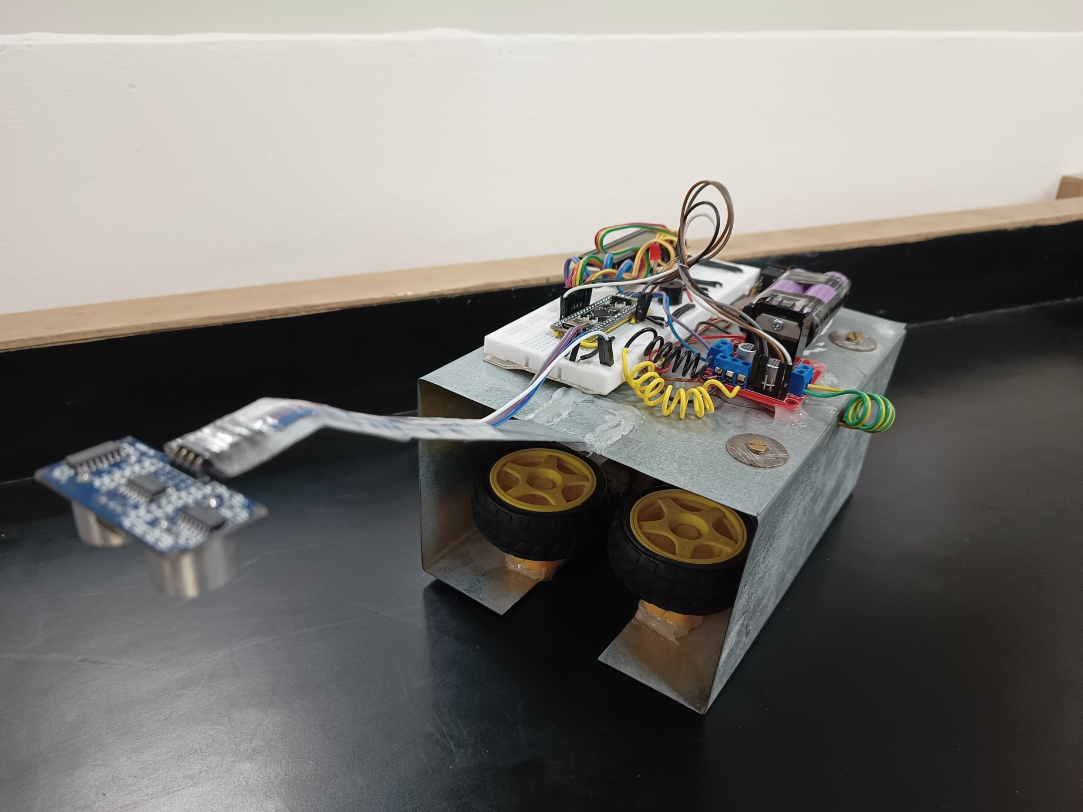
TRACK Inspection robot

Slide 2
Problem Statement
The Indian Railways encounters several challenges in track inspection. These challenges include the vastness of the railway network, making it difficult to inspect every part of the track effectively. Manual inspection methods are time-consuming, prone to errors, and struggle to cover remote areas with extreme weather conditions. The lack of modern technology such as drones, sensors, and inspection equipment hampers the identification of track defects, potentially leading to accidents. Additionally, human error during inspections can contribute to safety issues. To enhance track inspection and ensure passenger and cargo safety, greater investment in technology and infrastructure is needed within the Indian Railways.

Slide 3
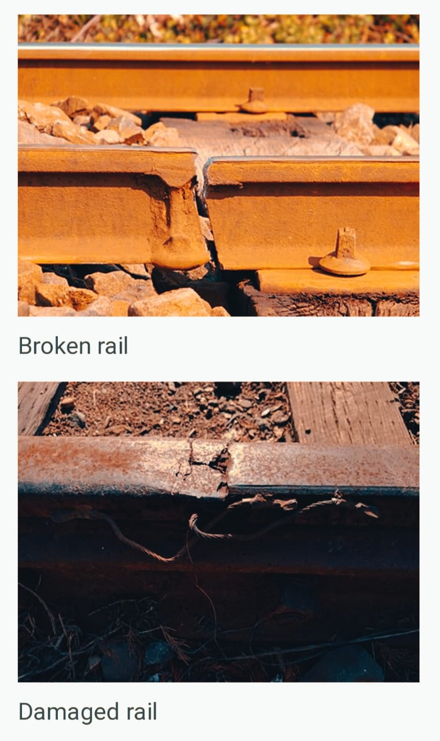
Solution
To overcome this problem of track inspection we have proposed the solution that, we will make a track inspection robot which will move on the track and collect the required data from the track i.e. it will check for any cracks or discontinues while monitoring the track. This approach not only ensures thorough & efficient track inspection but also minimizes the risk of accidents by providing prior information regarding the condition of tracks, so that immediate actions can be taken to fix the issue and ensure passengers and cargo safety, thus showcasing significant improvement over traditional manual inspection techniques.

Slide 4
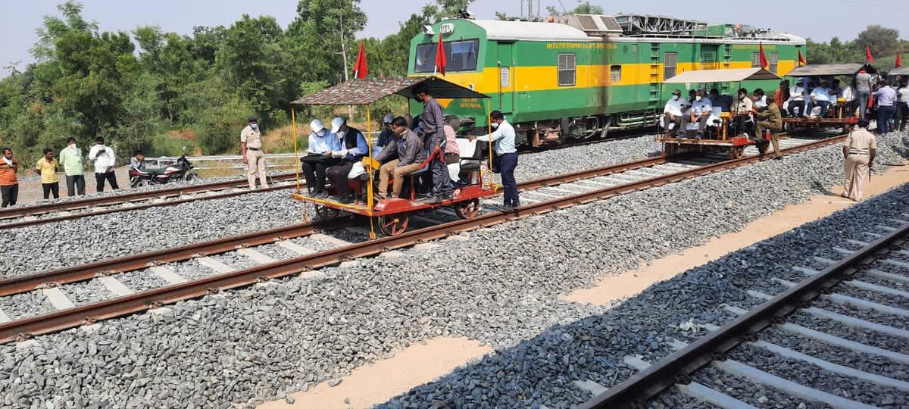
Manual inspection v/s inspection via robot
Manual Inspection :
Involves human inspectors walking along the tracks or using specialized vehicles.
Manual inspection is labor-intensive and may be time-consuming, especially for large stretches of railway tracks.
The effectiveness of the inspection depends on the attentiveness of the human inspector and may be subject to human error.
Inspections are scheduled at regular intervals, and issues may only be detected during these predetermined times.

Slide 5
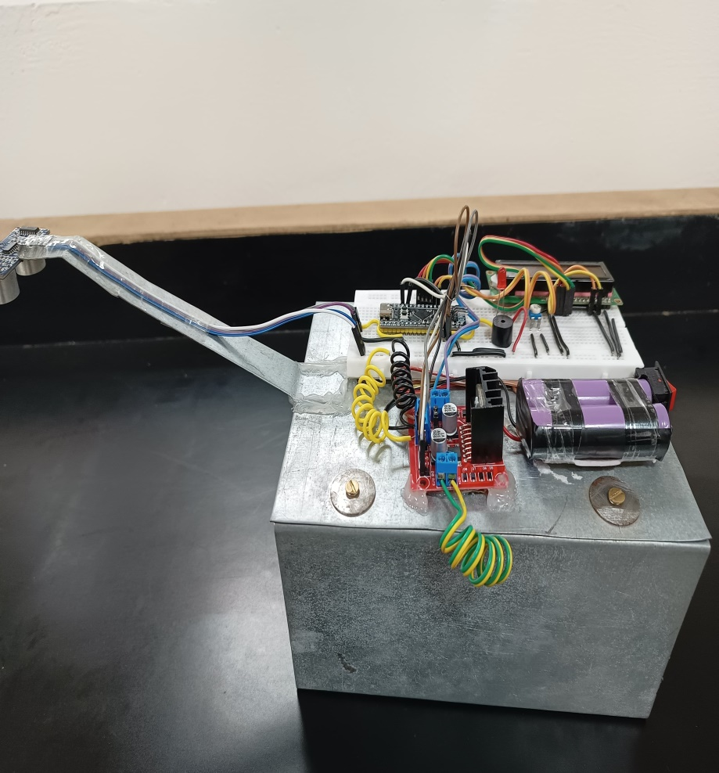
Manual inspection v/s inspection via robot
Robotic Inspection :
The robotic system autonomously moves along the tracks, eliminating the need for constant human intervention.
The robotic system can cover large distances efficiently, reducing the time required for inspections. It also provides real time data on the track’s condition, allowing immediate action in case of issues.
Minimizes the need for human inspectors to work in potentially hazardous environments, such as busy rail lines or remote locations.
Can operate continuously, allowing for more frequent inspections and early detection of issues.

Slide 6
Future scope of our idea!
In addition to revolutionizing track inspection for the Indian Railways, our proposed track inspection robot offers a promising future scope that enhances its functionality and impact. We will try to accommodate the following things in our next working prototype: :
GPS Integration : Enables live location tracking of the robot, enhancing the precision and organization of track inspections.
GSM Module : Facilitates seamless communication between the robot and the central control system, allowing for remote data transmission and quick response to potential track anomalies.
Camera Inclusion : Offers real-time visual monitoring capabilities, providing inspectors and operators with comprehensive views of track conditions during inspections.

